Slide 3
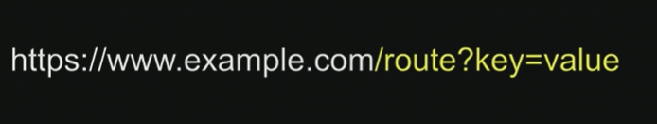

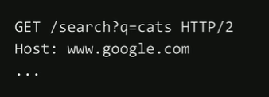

Slide 4
Flask is a framework
Command is
Flask run which starts a webserver
1st file is app.py - initial application, Python
2nd requirements.txt – list of requirements

Slide 5
from flask import Flask
app = Flask(__name__) # tell Flask to make this code a web application
# decorators - wrap a function inside another function
@app.route("/")
def index():
return "Hello, World!"

Slide 6
Flask Demo 01 : 3-page website
Flask Webserver
app.py
Index.html
About.html
Contact.html

Slide 7
Flask Demo 02 : using layout.html
Flask Webserver
app.py
Layout.html
About.html
Contact.html
Index.html
{% block A %}
{% endblock %}

Slide 8
